Slide 1
18CSC201J DATA STRUCTURES AND ALGORITHMS
UNIT 5
Kruskal’s Algorithm

Slide 2
Minimum Spanning Tree

Slide 3
Introduction
Spanning Tree
A tree (i.e., connected, acyclic graph) which contains all the vertices of the graph
Minimum Spanning Tree
Spanning tree with the minimum sum of weights
The minimum spanning tree is a tree because it is acyclic, it is spanning because it covers every vertex, and it is minimum because it covers with minimum cost.
b
8
c
7
d
4
9
2
a
11
i
4
14
e
8
7
6
10
g
g
f
1
2

Slide 4
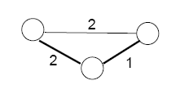
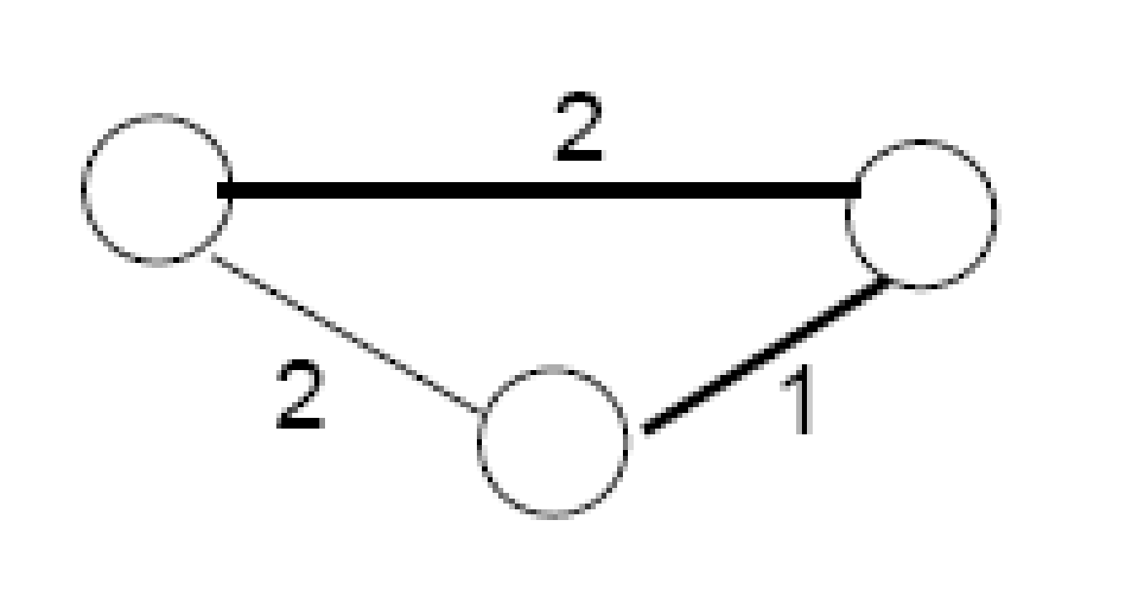
Properties of Minimum Spanning Trees
Minimum spanning tree is not unique
MST has no cycles – see why:
-We can take out an edge of a cycle, and still have the vertices connected while reducing the cost
# of edges in a MST:
|V| - 1

Slide 5
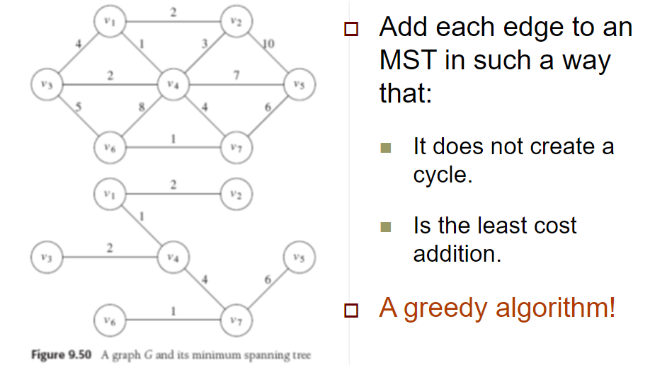
Properties of Minimum Spanning Trees
A greedy algorithm is an approach for solving a problem by selecting the best option available at the moment

Slide 6
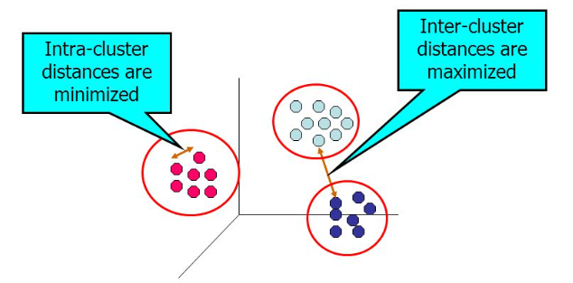
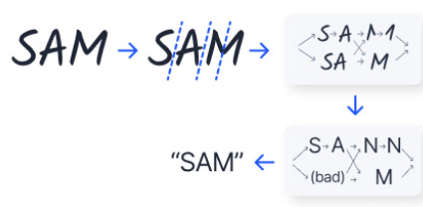
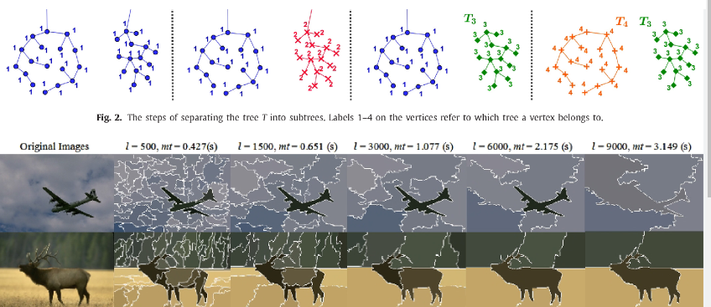
Applications of MST
Minimum spanning tree has direct application in the design of networks. It is used in algorithms approximating the travelling salesman problem, multi-terminal minimum cut problem and minimum-cost weighted perfect matching. Other practical applications are:
Cluster Analysis
Handwriting recognition
Image segmentation

Slide 7
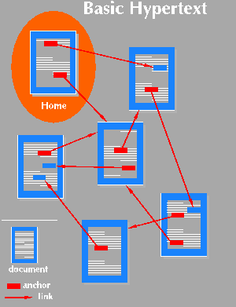

Applications of MST
Find the least expensive way to connect a set of cities, terminals, computers, etc.

Slide 8
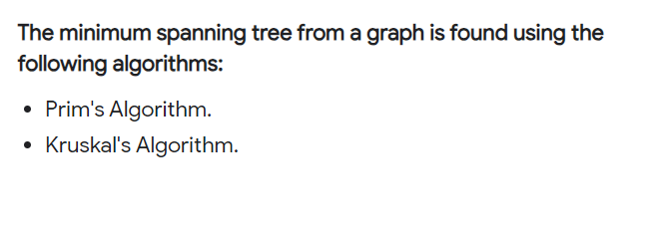
MST

Slide 9
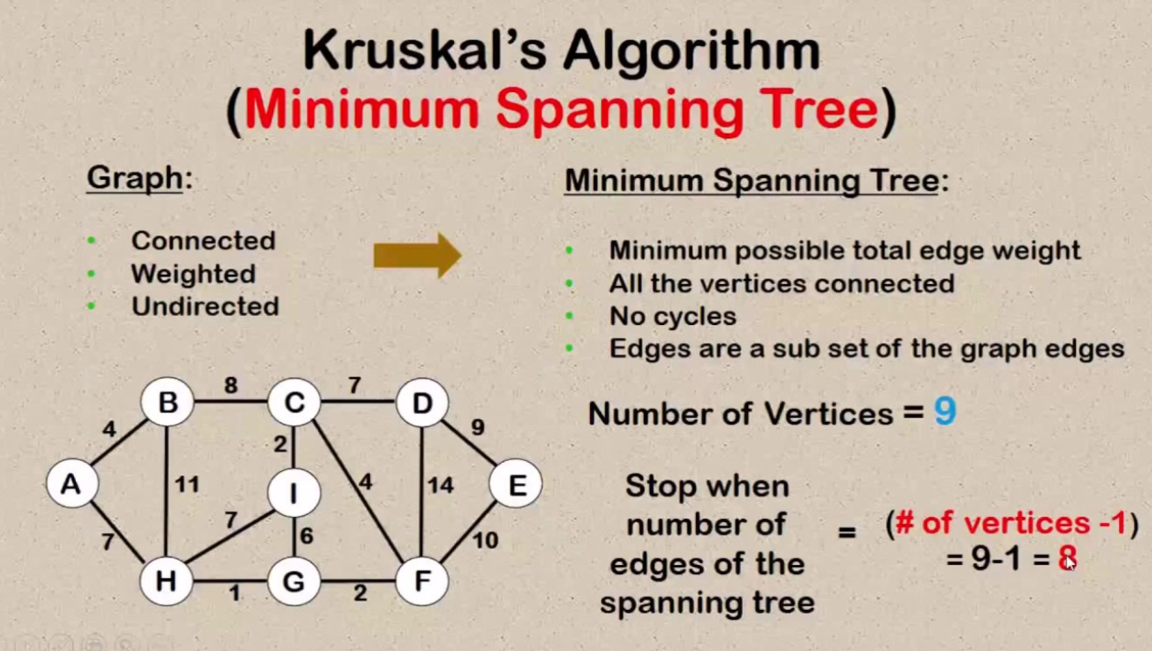

Slide 10
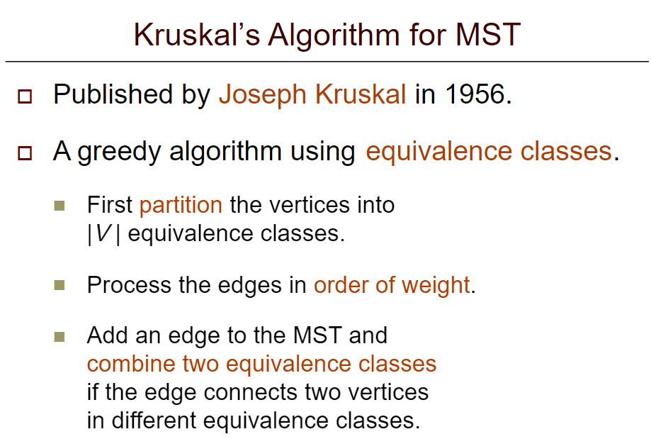

Slide 11
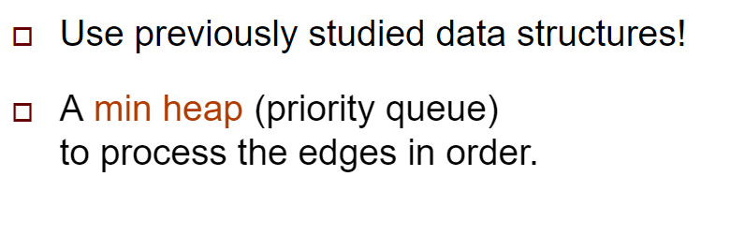
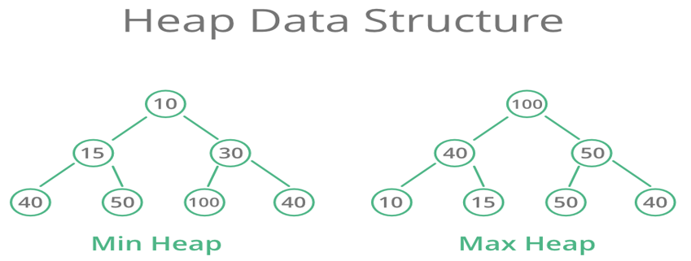

Slide 12
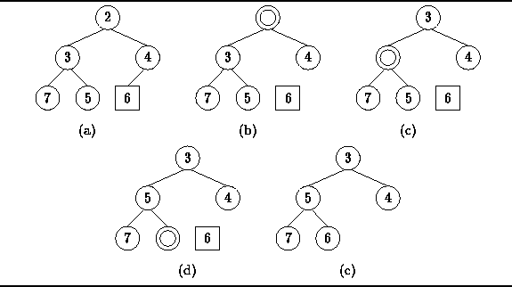
MIN HEAP DELETION OF NODE

Slide 13
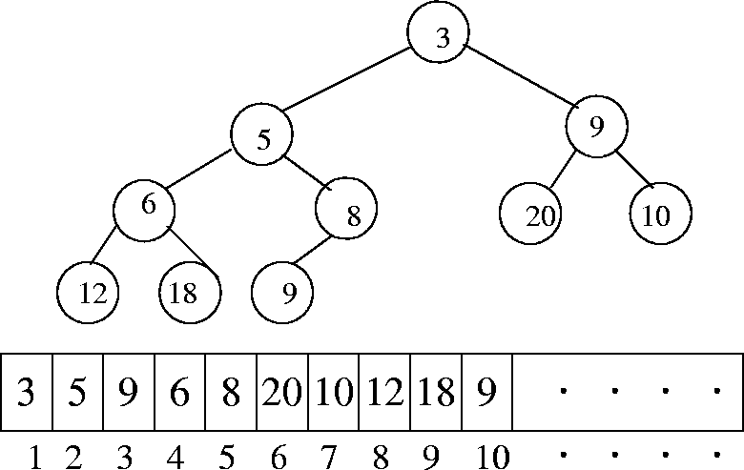
PRIORITY QUEUE

Slide 14
Kruskal’s Algorithm
Input : Graph with V edges
Output : Minimum Spanning tree with V-1 edges
Step 1. Sort all the edges in non-decreasing order of their weight.
Step 2. Pick the smallest edge. Check if it forms a cycle with the spanning tree formed so far. If cycle is not formed, include this edge. Else, discard it.
Step 3. Repeat step#2 until there are (V-1) edges in the spanning tree.

Slide 15
Example
3
4
2
3
4
3
4
5
2
2
5
9
6
1
1
12
8
8
10
9
7
7
The graph contains 9 vertices and 11 edges. So, the minimum spanning tree formed will be having (9 – 1) = 8 edges.

Slide 16
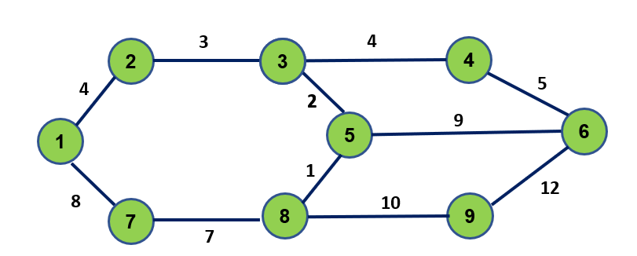
Sort the weights of the graph
Weight | Source | Destination
1 | 8 | 5
2 | 3 | 5
3 | 2 | 3
4 | 1 | 2
4 | 3 | 4
5 | 4 | 6
7 | 7 | 8
8 | 1 | 7
9 | 5 | 6
10 | 8 | 9
12 | 9 | 6

Slide 17
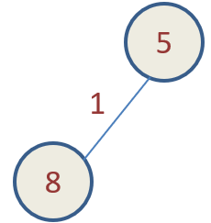
Now pick all edges one by one from sorted list of edges
Weight | Source | Destination
1 | 8 | 5
2 | 3 | 5
3 | 2 | 3
4 | 1 | 2
4 | 3 | 4
5 | 4 | 6
7 | 7 | 8
8 | 1 | 7
9 | 5 | 6
10 | 8 | 9
12 | 9 | 6

Slide 18
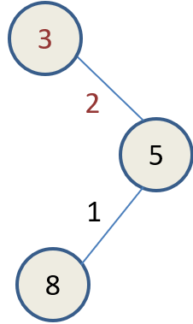
Weight | Source | Destination
1 | 8 | 5
2 | 3 | 5
3 | 2 | 3
4 | 1 | 2
4 | 3 | 4
5 | 4 | 6
7 | 7 | 8
8 | 1 | 7
9 | 5 | 6
10 | 8 | 9
12 | 9 | 6

Slide 19
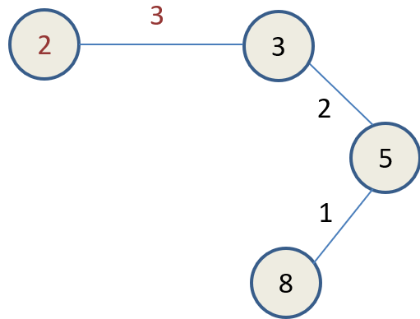
Weight | Source | Destination
1 | 8 | 5
2 | 3 | 5
3 | 2 | 3
4 | 1 | 2
4 | 3 | 4
5 | 4 | 6
7 | 7 | 8
8 | 1 | 7
9 | 5 | 6
10 | 8 | 9
12 | 9 | 6

Slide 20
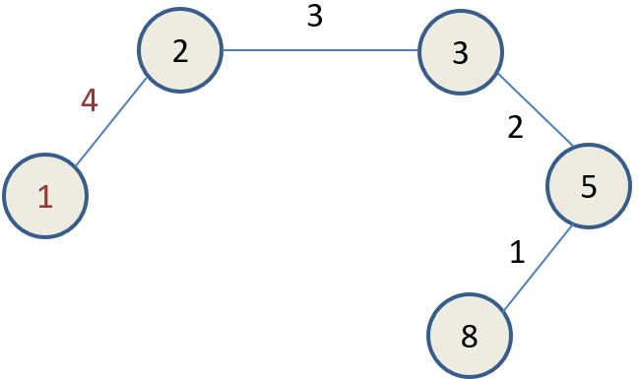
Weight | Source | Destination
1 | 8 | 5
2 | 3 | 5
3 | 2 | 3
4 | 1 | 2
4 | 3 | 4
5 | 4 | 6
7 | 7 | 8
8 | 1 | 7
9 | 5 | 6
10 | 8 | 9
12 | 9 | 6

Slide 21
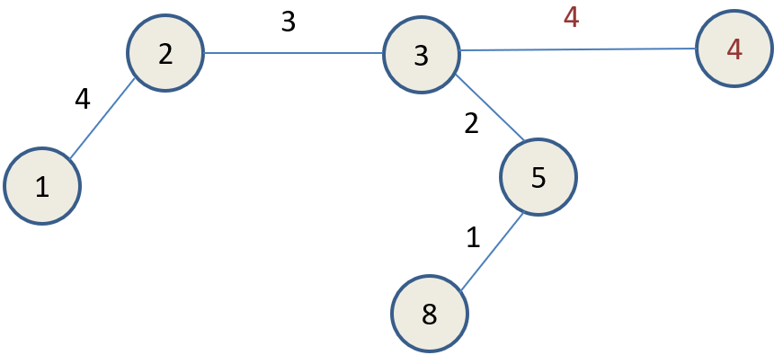
Weight | Source | Destination
1 | 8 | 5
2 | 3 | 5
3 | 2 | 3
4 | 1 | 2
4 | 3 | 4
5 | 4 | 6
7 | 7 | 8
8 | 1 | 7
9 | 5 | 6
10 | 8 | 9
12 | 9 | 6

Slide 22
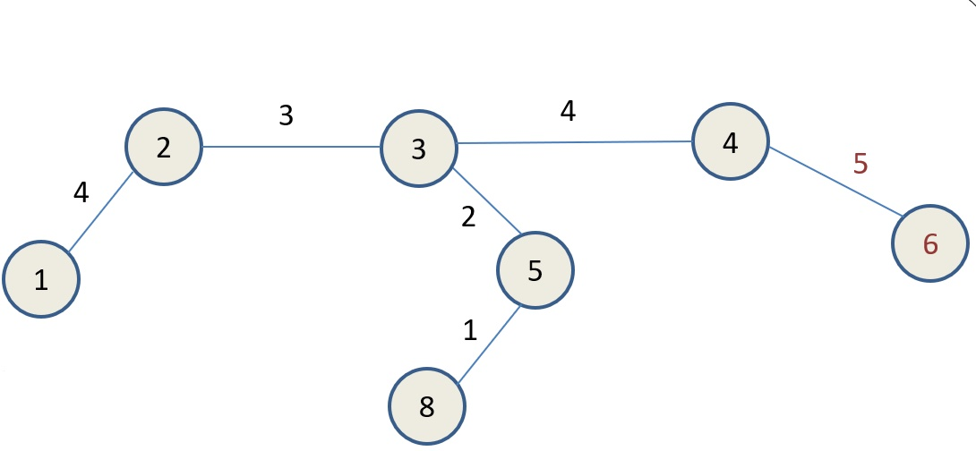
Weight | Source | Destination
1 | 8 | 5
2 | 3 | 5
3 | 2 | 3
4 | 1 | 2
4 | 3 | 4
5 | 4 | 6
7 | 7 | 8
8 | 1 | 7
9 | 5 | 6
10 | 8 | 9
12 | 9 | 6

Slide 23
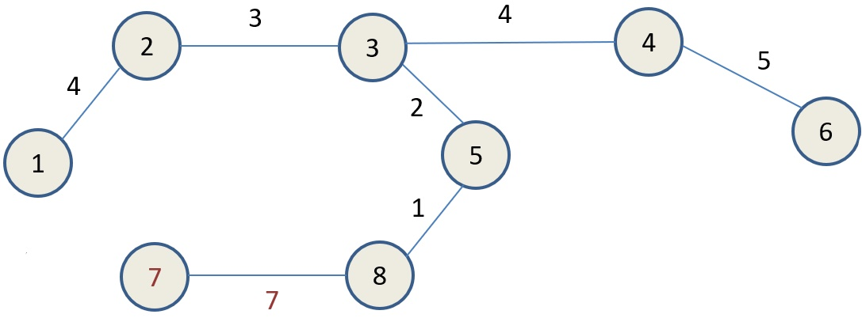
Weight | Source | Destination
1 | 8 | 5
2 | 3 | 5
3 | 2 | 3
4 | 1 | 2
4 | 3 | 4
5 | 4 | 6
7 | 7 | 8
8 | 1 | 7
9 | 5 | 6
10 | 8 | 9
12 | 9 | 6

Slide 24
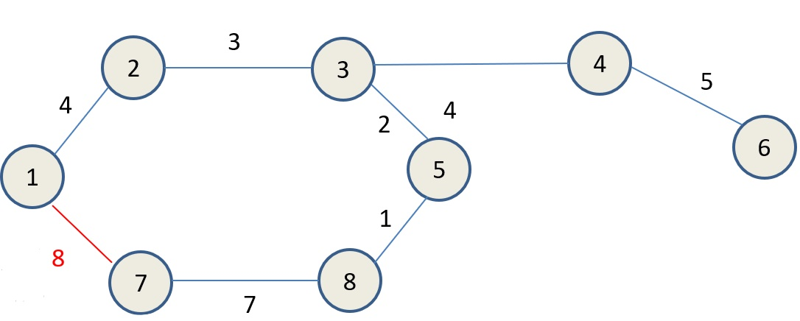
Weight | Source | Destination
1 | 8 | 5
2 | 3 | 5
3 | 2 | 3
4 | 1 | 2
4 | 3 | 4
5 | 4 | 6
7 | 7 | 8
8 | 1 | 7
9 | 5 | 6
10 | 8 | 9
12 | 9 | 6
Cycle is formed because of weight 8. hence it is discarded.

Slide 25
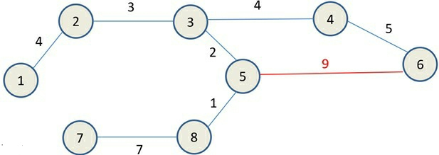
Weight | Source | Destination
1 | 8 | 5
2 | 3 | 5
3 | 2 | 3
4 | 1 | 2
4 | 3 | 4
5 | 4 | 6
7 | 7 | 8
8 | 1 | 7
9 | 5 | 6
10 | 8 | 9
12 | 9 | 6
Cycle is formed because of weight 9. hence it is discarded.

Slide 26
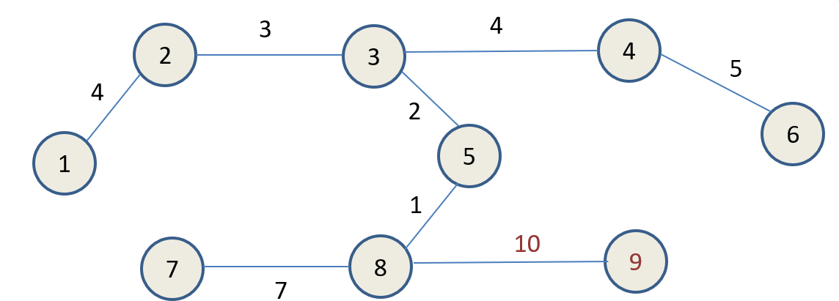
Weight | Source | Destination
1 | 8 | 5
2 | 3 | 5
3 | 2 | 3
4 | 1 | 2
4 | 3 | 4
5 | 4 | 6
7 | 7 | 8
8 | 1 | 7
9 | 5 | 6
10 | 8 | 9
12 | 9 | 6
Cycle is formed because of weight 12. hence it is discarded.

Slide 27
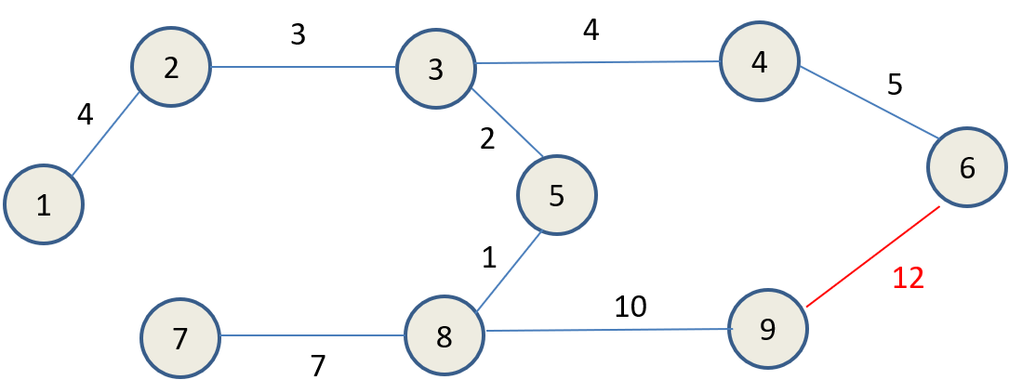
Weight | Source | Destination
1 | 8 | 5
2 | 3 | 5
3 | 2 | 3
4 | 1 | 2
4 | 3 | 4
5 | 4 | 6
7 | 7 | 8
8 | 1 | 7
9 | 5 | 6
10 | 8 | 9
12 | 9 | 6
Cycle is formed because of weight 12. hence it is discarded.

Slide 28
3
4
2
3
4
5
4
2
6
1
5
1
7
8
10
9
7
Minimum Spanning tree generated by Kruskal’s algorithm

Slide 29
Kruskal’s Algorithm
void kruskal( graph G ) {
int EdgesAccepted;
DisjSet S; // A pair of sets which does not have any common element are called disjoint sets.
PriorityQueue H; vertex u, v; SetType uset, vset; Edge e;
Initialize( S ); // form a single node tree
ReadGraphIntoHeapArray( G, H );
BuildHeap( H );
EdgesAccepted = 0;
while( EdgesAccepted < NumVertex-1 )
{
e = DeleteMin( H ); // Selection of minimum edge
uset = Find( u, S );
vset = Find( v, S );
if( uset != vset ) {
/* accept the edge */ EdgesAccepted++; SetUnion( S, uset, vset );
} }}

Slide 30
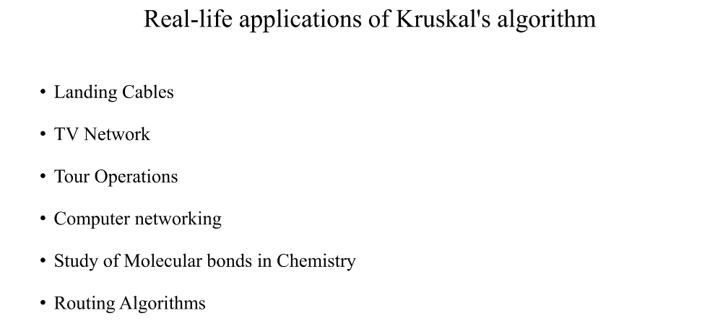
Kruskal’s Algorithm

Slide 31
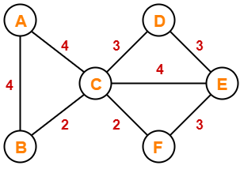
Exercise
Convert the graph given below to minimum spanning tree using kruskals algorithm.

Slide 32
Review Questions
1.Kruskal’s Algorithm is preferred when the graph is ____and there are ____number of edges in the graph.
2.If all the edge weights are not distinct, then prims and kruskals algorithms _____ always produce the same MST.
3. The cost of both the MST_{s} produced by prims and kruskals algorithm would always be _____.
4. Let ‘m’ and ‘n’ be the number of edges and vertices in a graph G, respectively. The time complexity of the kruskals algorithm is ______.

Slide 33
References:
1. A.V.Aho, J.E Hopcroft , J.D.Ullman, Data structures and Algorithms, Pearson Education, 2003
2. Reema Thareja, Data Structures Using C, 1st ed., Oxford Higher Education, 2011

